Slide 1
Smart Parking for a Smart City
By-
Notes:
PROJECT - Smart Parking for a Smart City

Slide 2
AGENDA
Introduction​
Goals
​Overview of the Data
Box Plots
Timeline/Time dependent
​Recommendation
Challenges
Conclusion
Notes:
FOLLOWING ARE THE AGENDAS WE WILL COVER –
Introduction​
Goals
​Overview of the Data
Box Plots
Timeline/Time dependent
​Recommendation
Challenges
Conclusion

Slide 3
Introduction
In this presentation, we will outline the rationale and goals of the project, provide an analysis of our data, and make a recommendation about whether to continue with the implementation of this project.
Our aim is to leverage data analytics to improve traffic flow and quality of life in our city by introducing a smart parking app.
Notes:
INTRODUCTION TO THE PROJECT –
In this presentation, we will outline the rationale and goals of the project, provide an analysis of our data, and make a recommendation about whether to continue with the implementation of this project.
Our aim is to leverage data analytics to improve traffic flow and quality of life in our city by introducing a smart parking app.

Slide 4
Rationale and Goals
The goals of the project are as follows:
To improve traffic flow in our city by reducing the time it takes for motorists to find parking.
To reduce congestion on our roads and highways.
To increase economic activity by making it easier for people to visit and shop in our city.
To reduce air pollution by reducing the time cars spend idling in search of parking spaces.
To enhance the quality of life for our residents and visitors.
By achieving these goals, we can move our city towards becoming a smarter, more sustainable city.
Notes:
The purpose of this project is to introduce a smart parking app to improve traffic flow and quality of life in our city.
The Main goals of the project are as follows:
To improve traffic flow in our city by reducing the time it takes for motorists to find parking.
To reduce congestion on our roads and highways.
To increase economic activity by making it easier for people to visit and shop in our city.
To reduce air pollution by reducing the time cars spend idling in search of parking spaces.
To enhance the quality of life for our residents and visitors.
By achieving these goals, we can move our city towards becoming a smarter, more sustainable city.

Slide 5
Overview of the Data
Description of the dataset used for the analysis:
Data collected from parking lots in the city
Includes LotCode, LotCapacity, LotOccupancy, TimeStamp, and Day columns
Variables included in the dataset:
LotCode: Unique code that identifies the parking lot
LotCapacity: The number of parking spots in the parking lot
LotOccupancy: The current number of cars parked in the lot
TimeStamp: The date and time when occupancy was measured
Day: The day of the week corresponding to the TimeStamp
Occupancy Rate: LotOccupancy/ LotCapacity ( in %)
Notes:
Overview of the Data
Description of the dataset used for the analysis:
Data collected from parking lots in the city
Includes LotCode, LotCapacity, LotOccupancy, TimeStamp, and Day columns

Slide 6
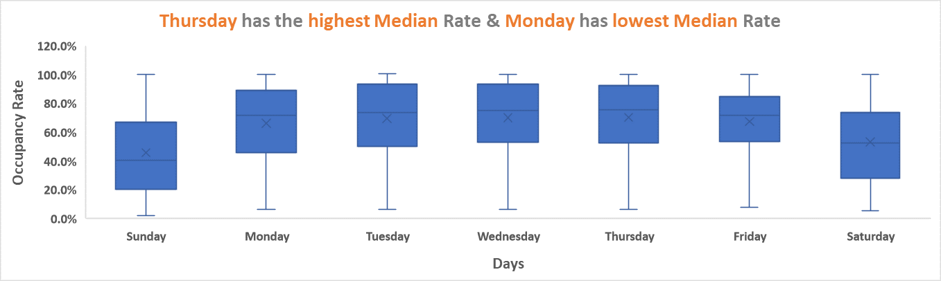
Occupancy Rates by Day
Interpretation of the results: The median occupancy rate is approximately the same from Monday to Friday Saturday and Sunday have lower median occupancy rates compared to weekdays. Looking at the box plots, we can see that the median occupancy rate is approximately the same throughout the week.
There is some variation between the days, with Tuesday, Wednesday & Thursday showing slightly higher median occupancy rates than the rest of the week. This is somewhat what we would expect, as these are typically busier days in many cities.
Box plots showing the occupancy rates for each day of the week
Notes:
The graph above shown is of - Occupancy Rates by Day
The interpretation to the result is as follows-
The median occupancy rate is approximately the same from Monday to Friday Saturday and Sunday have lower median occupancy rates compared to weekdays. Looking at the box plots, we can see that the median occupancy rate is approximately the same throughout the week.
There is some variation between the days, with Tuesday, Wednesday & Thursday showing slightly higher median occupancy rates than the rest of the week. This is somewhat what we would expect, as these are typically busier days in many cities.
Comparison of median occupancy Monday: 72% Tuesday: 74% Wednesday: 75% Thursday: 76% Friday: 72% Saturday: 53% Sunday: 40%

Slide 7
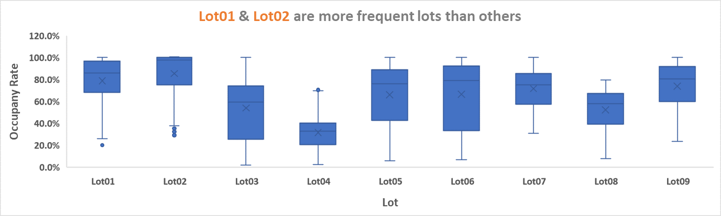
Occupancy Rates by parking lots
Interpretation of the results: Looking at the box plots, we can see that not all parking lots experience approximately equal occupancy rates. Some parking lots have a much higher median occupancy rate than others such as Lot 1 and Lot 2, indicating that they are more frequently used. This is what we would expect, as some parking lots may be more convenient or located in more popular areas. Comparison of median occupancy
Lot-1 | 86.0%
Lot-2 | 97.7%
Lot-3 | 59.3%
Lot-4 | 32.8%
Lot-5 | 76.3%
Lot-6 | 79.3%
Lot-7 | 75.4%
Lot-8 | 58.0%
Lot-9 | 80.5%
Box plots showing the occupancy rates for each parking lots
Notes:
The graph above shown is of - Occupancy Rates by Day
The interpretation of the result is-
Looking at the box plots, we can see that not all parking lots experience approximately equal occupancy rates. Some parking lots have a much higher median occupancy rate than others such as Lot 1 and Lot 2, indicating that they are more frequently used. This is what we would expect, as some parking lots may be more convenient or located in more popular areas.

Slide 8
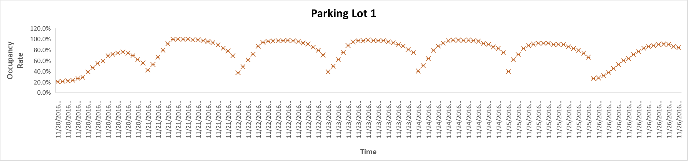
Time-Dependent Occupancy Rates
Scatter plot for parking Lot-01 with each date and time.
Looking at the scatter plots, we can see that occupancy rates are time-dependent, with some times experiencing higher occupancy rates than others such as 9:30 to 17:00. The exact times vary between the two parking lots we selected, but in general, we can see higher occupancy rates during the middle of the day (such as approx. 9:30 to 17:00) and lower occupancy rates during the early morning and late evening. This is somewhat what we would expect, as people tend to use parking lots more during the day when they are working or running errands, and less during the early morning and late evening when they are at home.
Notes:
The above graph is of – Scatter plot for parking Lot-01 with each date and time.
Looking at the scatter plots, we can see that occupancy rates are time-dependent, with some times experiencing higher occupancy rates than others such as 9:30 to 17:00. The exact times vary between the two parking lots we selected, but in general, we can see higher occupancy rates during the middle of the day (such as approx. 9:30 to 17:00) and lower occupancy rates during the early morning and late evening. This is somewhat what we would expect, as people tend to use parking lots more during the day when they are working or running errands, and less during the early morning and late evening when they are at home.

Slide 9
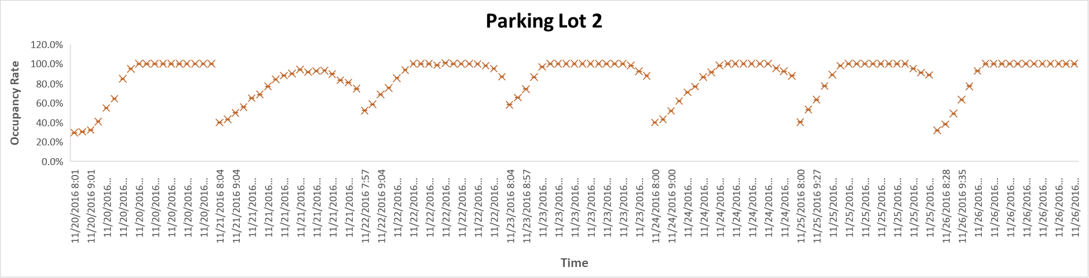
Time-Dependent Occupancy Rates
Scatter plot for parking Lot-02 with each date and time.
Looking at the scatter plots, we can see that occupancy rates are time-dependent, with some times experiencing higher occupancy rates than others such as 9:30 to 17:00. The exact times vary between the two parking lots we selected, but in general, we can see higher occupancy rates during the middle of the day (such as approx. 9:30 to 17:00) and lower occupancy rates during the early morning and late evening. This is somewhat what we would expect, as people tend to use parking lots more during the day when they are working or running errands, and less during the early morning and late evening when they are at home.
Notes:
Scatter plot for parking Lot-02 with each date and time
Looking at the scatter plots, we can see that occupancy rates are time-dependent, with some times experiencing higher occupancy rates than others such as 9:30 to 17:00. The exact times vary between the two parking lots we selected, but in general, we can see higher occupancy rates during the middle of the day (such as approx. 9:30 to 17:00) and lower occupancy rates during the early morning and late evening. This is somewhat what we would expect, as people tend to use parking lots more during the day when they are working or running errands, and less during the early morning and late evening when they are at home.

Slide 10
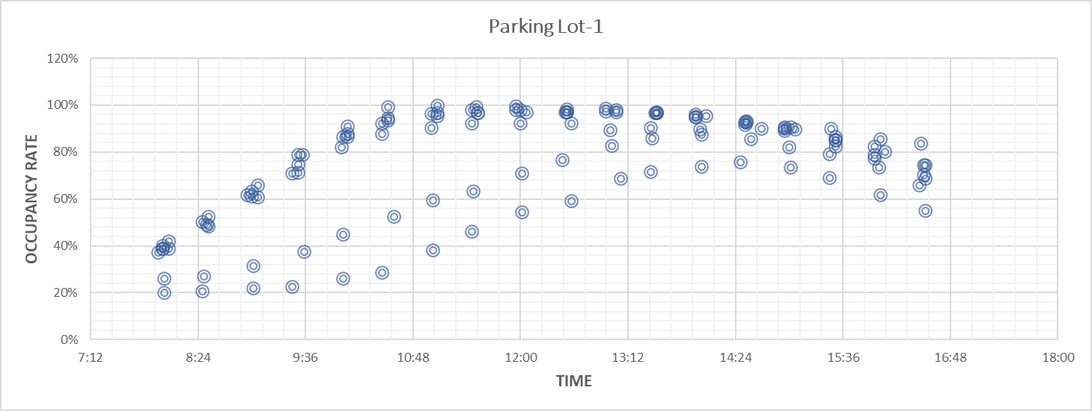
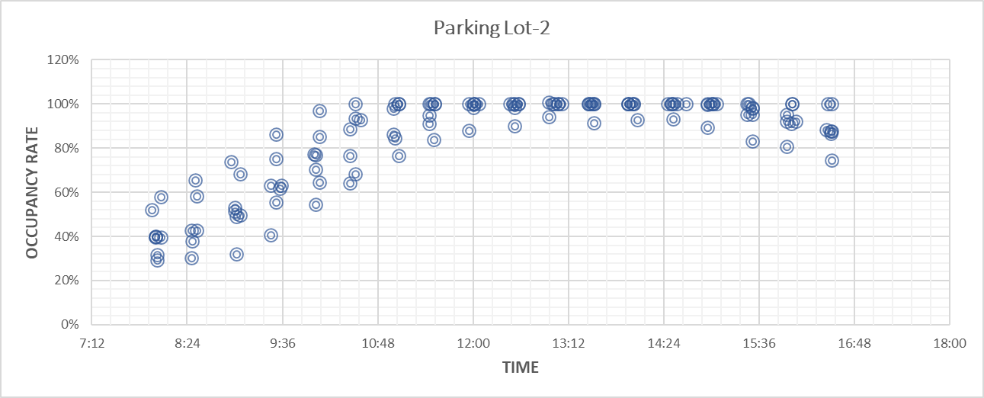
This graph is showing parking lot 1 with a cumulative time in 24 hours for the whole week
This graph is showing parking lot 2 with a cumulative time in 24 hours for the whole week
The above both the graph are scatter plot for parking lot-1 and lot-2, respectively but with a cumulative time of whole week. Looking at the booth the graph we can say that yes the values are time dependent. As we can see that the maximum 100% occupancy rate has reached during the office hours approx. 09:30 to 17:00, whereas are low during the other hours. The same can be seen if we look at the data with separate date nd time stamp as in the above slide. Hence we can conclude that its time-dependent

Slide 11
recommendation
The reasons for this recommendation are as follows:
Improved parking management: The Smart Parking Space app will help to improve parking management by providing real-time data on parking availability and reducing traffic congestion.
Increased revenue: The implementation of the app will likely lead to increased revenue generation, as it will allow for more efficient use of parking spaces, and people will be more likely to park in areas where they know they can find available spaces.
Enhanced customer experience: With the app's help, customers will be able to quickly and easily find available parking spaces, making their parking experience more convenient and stress-free.
Positive impact on the environment: The Smart Parking Space app will contribute to the reduction of carbon emissions by minimizing the time spent driving around looking for a parking space.
Therefore, based on these factors, it is recommended that the City Council invest in the resources to set in motion the Smart Parking Space app.
Notes:
The reasons for this recommendation are as follows:
Improved parking management: The Smart Parking Space app will help to improve parking management by providing real-time data on parking availability and reducing traffic congestion.
Increased revenue: The implementation of the app will likely lead to increased revenue generation, as it will allow for more efficient use of parking spaces, and people will be more likely to park in areas where they know they can find available spaces.
Enhanced customer experience: With the app's help, customers will be able to quickly and easily find available parking spaces, making their parking experience more convenient and stress-free.
Positive impact on the environment: The Smart Parking Space app will contribute to the reduction of carbon emissions by minimizing the time spent driving around looking for a parking space.
Therefore, based on these factors, it is recommended that the City Council invest in the resources to set in motion the Smart Parking Space app.

Slide 12
challenges and limitations
Data quality and accuracy: The accuracy and quality of the data used for the project can be a major limitation. If the data is not accurate, the analysis and conclusions drawn from it will not be reliable. To overcome this, we need to ensure that the data is collected from reliable sources and is cleaned.
Infrastructure requirements: The implementation of the smart parking space app requires a significant investment in infrastructure, such as sensors, cameras, and communication networks.. To overcome this, the project can be implemented in phases, starting with a pilot program to test the feasibility of the project.
Privacy concerns: The use of sensors and cameras for data collection can raise privacy concerns among the public. To overcome this, the project should be transparent about its data collection practices and ensure that the data collected is anonymized and used only for the purpose of improving parking management.
User adoption: The success of the project depends on user adoption. If the app is not user-friendly and does not provide clear benefits to users, they may not use it. To overcome this, the app should be designed to be user-friendly and provide clear benefits, such as time and cost savings for users

Slide 13





PLAN FOR LAUNCH
PLANNING
MARKETING
DESIGN
STRATEGY
LAUNCH
Synergize scalable
Disseminate standardized metrics
Coordinate e- business applications
Foster holistically
Deploy strategic networks
Notes:
The above mentioned is a plan for launch

Slide 14
CONCLUSION
In conclusion, the smart parking space app can be an effective solution to alleviate parking-related problems in the city, and the benefits of the project outweigh the challenges and limitations. Further research and development are necessary to improve the app's functionality and overcome the challenges. Acknowledgments to the sources used in the analysis and future recommendations for the project were also provided.
Resources you can use to learn more about smart cities:
"What is a Smart City?" by the Smart Cities Council -https://smartcitiescouncil.com/article/what-smart-city
"Smart Cities: A Comprehensive Guide" by Deloitte https://www2.deloitte.com/content/dam/Deloitte/uk/Documents/public-sector/deloitte-uk-smart-cities-guide.pdf
"Smart Cities: Overview and Opportunities" by the National League of Cities https://www.nlc.org/resource/smart-cities-overview-and-opportunities
"The Role of Open Data in Smart Cities" by the Harvard Business Review https://hbr.org/2019/01/the-role-of-open-data-in-smart-cities
Notes:
In conclusion, the smart parking space app can be an effective solution to alleviate parking-related problems in the city, and the benefits of the project outweigh the challenges and limitations. Further research and development are necessary to improve the app's functionality and overcome the challenges. Acknowledgments to the sources used in the analysis and future recommendations for the project were also provided.

Slide 15
THANK YOU

